Slide 1
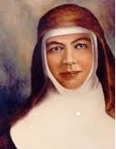
Mary MacKillop 1842-1909 Canonized St Mary of the Cross 2010

Slide 2
Opening Song

Slide 3
On the 8th August every year we celebrate and remember that Mary MacKillop loved God. She was a caring person who always helped others.

Slide 4
Liturgy of the Word First Reading: From St Paul’s letter to the Corinthians 3:12-17 Bear with one another; forgive one another if one of you has a complaint against another. The Lord has forgiven you; now you must do the same. Let the Word of Christ, in all its richness, find a home with you. The Word of the Lord. All: Thanks be to God.

Slide 5
Response: We will try to be more like Mary. All: We will try to be more like Mary. Reader: Mary MacKillop said: bear with and help one another. All: We will try and be more like Mary. Reader: Mary MacKillop wrote: Forgiveness is love. All: We will try and be more like Mary.

Slide 6
Gospel Acclamation: Alleluia, Alleluia! How truly wonderful are God’s ways. Alleluia!

Slide 7
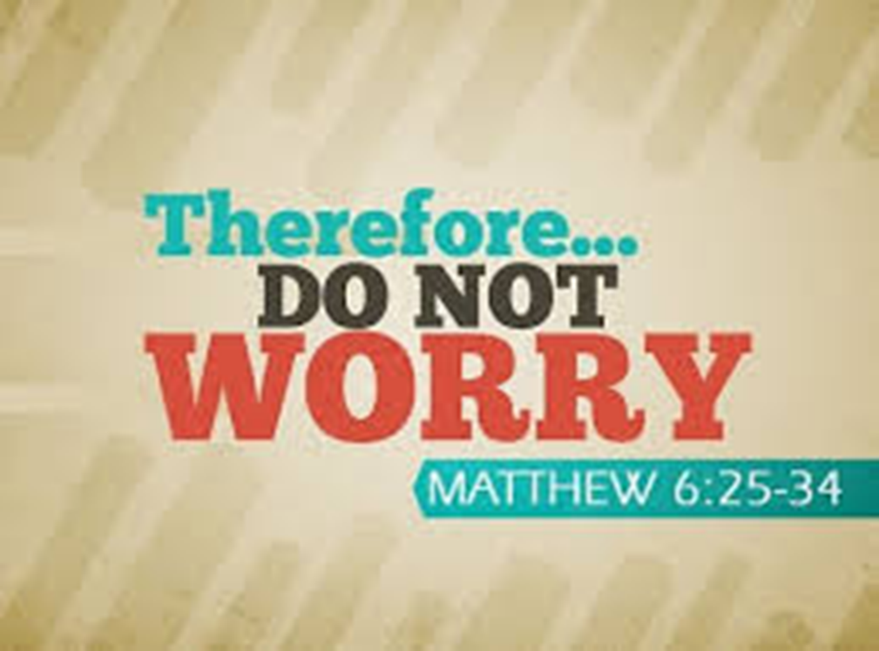
The Lord be with you.
All: And with your spirit.
A reading from the holy Gospel according to Matthew
All: Glory to you, O Lord.

Slide 8
I am telling you not to worry about your life and what you are to eat, nor about your body and how you are to clothe it. Surely life means more than food, and the body more than clothing! Look at the birds in the sky.

Slide 9
They do not sow or reap or gather into barns; yet your heavenly Father feeds them. Are you not worth much more than they are? Can any of you, for all your worrying, add one single cubit to the span of your life?

Slide 10
And why worry about clothing? Think of the flowers growing in the fields; they never have to work or spin; yet I assure you that not even Solomon in all his regalia was robed like one of these.

Slide 11
Now if that is how God clothes the grass in the field which is here today and thrown into the furnace tomorrow, will He not much more look after you, you people of little faith? So do not worry, do not say,

Slide 12
“What are we to eat? What are we to drink? How are we to be clothed?” It is the pagans who set their hearts on all these things. Your heavenly Father knows you need them all.

Slide 13
Set your hearts on His kingdom first, and His righteousness, and all these other things will be given you as well.

Slide 14
So do not worry about tomorrow; tomorrow will take care of itself. Each day has enough trouble of its own. The Gospel of the Lord. All: Praise to you, Lord Jesus Christ. (Please sit) .

Slide 15
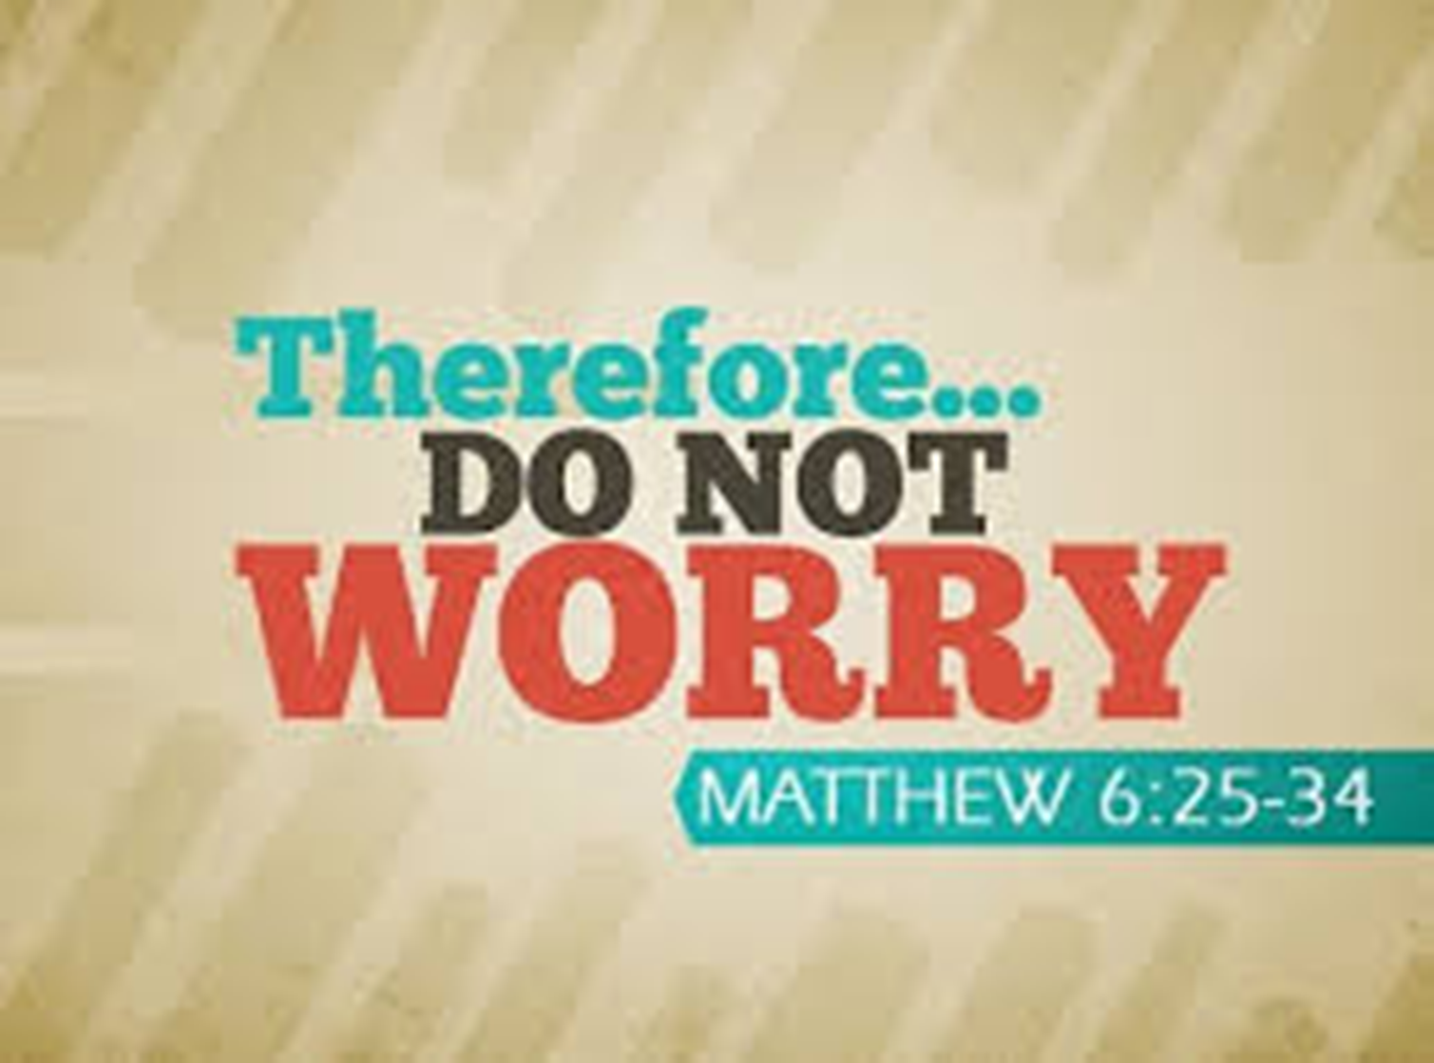

Slide 16
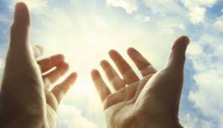
n

Slide 17
Reader: For sending us Mary MacKillop, who taught us how to love others. All: Thank you God. Reader: For the Sisters of St Joseph who do the work of Mary MacKillop. All: Thank you God.

Slide 18
Reader: For the people Mary helped and loved, the poor, the sick and the lonely. All: Thank you God. Reader: For our country Australia, which is safe and free. All: Thank you God.

Slide 19
Reader: For Pope Francis and all Church leaders, that through their good example and strong leadership, we will work together to help others. Lord hear us. All: Lord hear our prayer.

Slide 20
Reader: For those around us who make decisions, that they will always place their trust in God. Lord hear us. All: Lord hear our prayer.

Slide 21
Leader: For all who are sick and the lonely. Give them strength and confidence in a loving God. Lord hear us. All: Lord hear our prayer.

Slide 22
Leader: Mary always cared for anyone in need, and from her home in heaven now she keeps on praying for anyone who needs help.

Slide 23
Reflective Song:

Slide 25
Mary MacKillop lived a long time ago, but we remember her still today because she was a friend to everyone who needed her. When Mary saw poor children who didn’t have any education, she taught them herself and started a school for them in an old stable.

Slide 26
Many other young women joined with Mary MacKillop as Sisters of St Joseph. Soon there were schools for poor children all over Australia. However, Mary saw many other needs besides schools, and soon the Sisters were looking after orphan children and homeless girls. They also visited the sick, the lonely and elderly people.

Slide 27
Mary’s life was very hard. Her family was poor and so were the Sisters of St. Joseph. But Mary didn’t worry about the future. She always believed God would take care of her, and she worked hard at what she felt God wanted her to do.

Slide 28
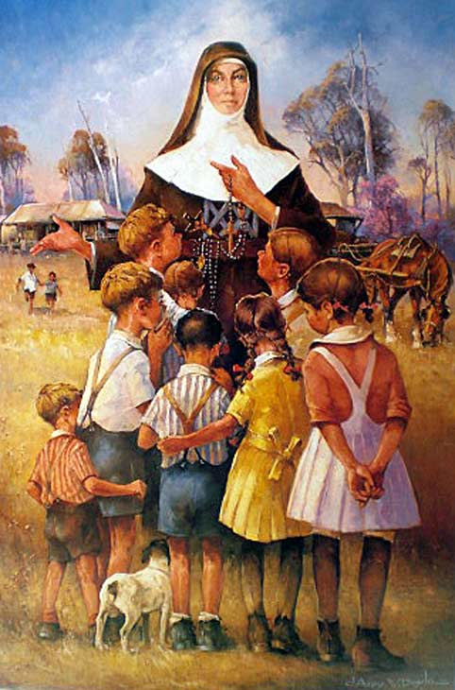
During her lifetime, many people thought of Mary MacKillop as a friend because she loved them and cared for them. Even though she lived and died a long time ago there are many people now who think of Mary MacKillop as their friend, and so can we.

Slide 29
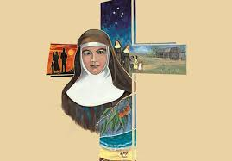
Closing Prayer On this celebration of Saint Mary of the Cross, strengthen us to walk the way of the Cross. We ask this through Christ our Lord.

Slide 30
Closing Song

Slide 31
