Slide 1

I WONDER HOW SAINTS CAN HELP US
BE MORE LIKE JESUS?

Slide 2
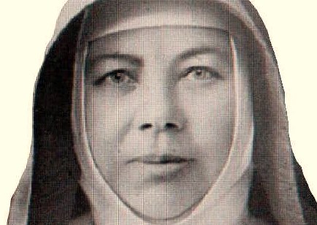
A Saint can show me how to love Jesus more by the way they lived their life.
Each story is different, but all Saints loved God with all their hearts.

Slide 3
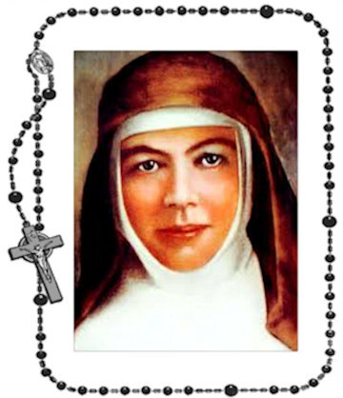

A Saint inspires me to pray to God more, so I grow in my love for Him, when I spend time with God.

Slide 4
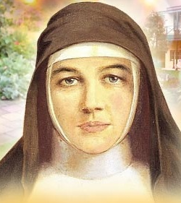
A Saint shows me Jesus’ light in the world and are an example for me to follow them.

Slide 5
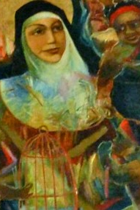
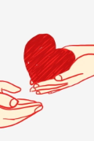
A Saint reminds me to give other people
God’s love, like Jesus did.

Slide 6

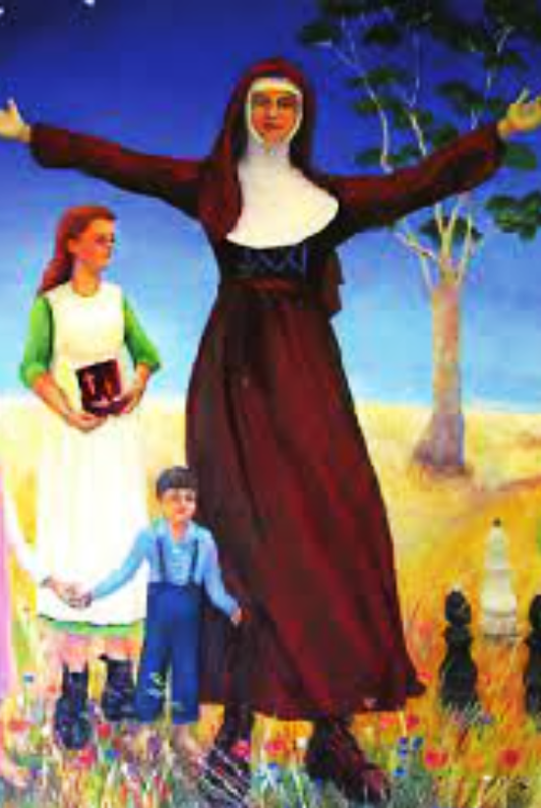
A Saint helps me to know that even if we have hard times, to keep holding onto the love of God.

Slide 7
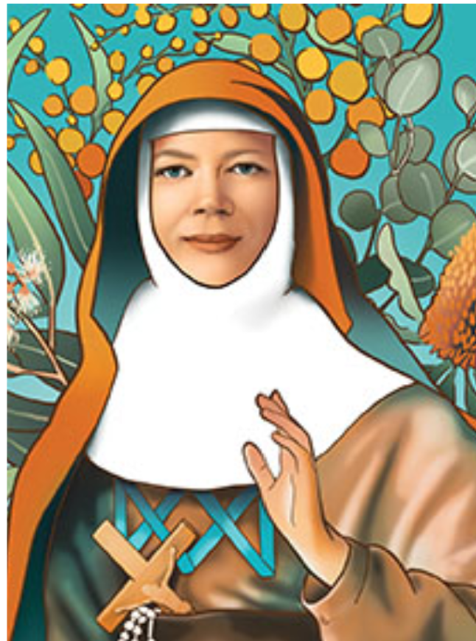


Saints can show me how to treat others people with great respect and kindness.
I am Jesus’ hands and feet in the world.

Slide 8
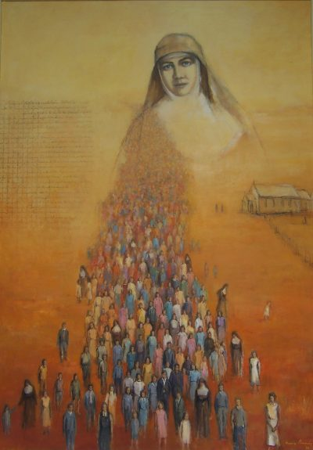
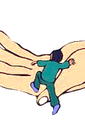
A Saint encourages me to believe that no matter whatever happens, Jesus is with me all the time.

Slide 9
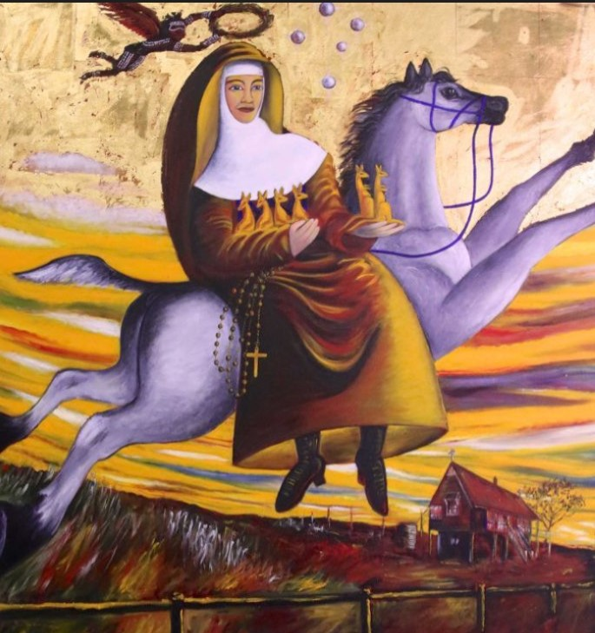
We are called to be Saints!

Slide 10


How can you follow Jesus in your story being a Saint?

